Slide 1
Student
Institution
Course
Date

Slide 2
Ethical Concern
Notes:
Welcome

Slide 3
Introduction:
The ethical concern in this scenario occurred when the company used patient’s DNA for research without the patient’s consent, (Ulrich et al, 2010).
Our Main Question: Is using patient’s DNA unethical or is a step forward in research world?
Notes:
Ethical issue is something that can’t be taken for granted in health care. Healthcare professions are entrusted with provision of daily care, long term care and helping those in need of regular care and serious health care. This presentation will help guide a potential researcher into answers and opinions, without swaying their views.

Slide 4
Principles of Ethics.
There are different principles of ethics that any researcher must adhere to, which include;
Consent
Deception
Right to withdraw
competence
Anonymity
Confidentiality
Non-maleficence
Notes:
This slide shows the principles of research ethics. According to the slide, the researcher should ensure that the research doesn’t harm the person and should be done to help the others. Using person’s DNA without his or her consent is beneficence but it’s not non-maleficence as it might cause harm to the person involved in the research.

Slide 5
Keeping the Patient’s information anonymous
It is possible to use DNA for research and Keep the Patient’s information Anonymous, (Austin, 2007).
The following can be used to keep the patient’s information anonymous;
Encryptions and Firewall
Audit trails
HIPAA privacy and security rules
Using access controls.
Notes:
The DNA information of human traits is inherited from parents and family members, thus there is need to be highly confidential. Today’s technology allows for computer firewalls, and encryption. They protect both the researcher and the subjects.

Slide 6
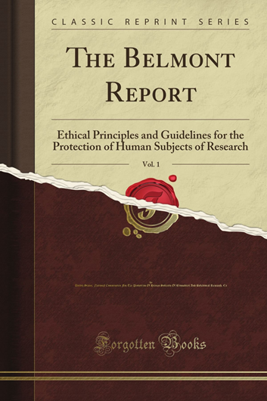



Values of Unethical Healthcare Research
The human experimentation has led to current modern medicine, though unethical and inhumane, (Varcoe et al, 2004).
The modern medicine comprises of organ transplantation, preventive care, germ theory among others.
The research must follow the following procedure.
Notes:
The slide shows the values of unethical Healthcare research. Moreover, the research must go through the above procedure to be certified; Belmont report- IRB – Approval.

Slide 7
References
Ulrich, C. M., Taylor, C., Soeken, K., O’Donnell, P., Farrar, A., Danis, M., & Grady, C. (2010). Everyday ethics: ethical issues and stress in nursing practice. Journal of advanced nursing, 66(11), 2510-2519.
Austin, W. (2007). The ethics of everyday practice: Healthcare environments as moral communities. Advances in Nursing Science, 30(1), 81-88.
Varcoe, C., Doane, G., Pauly, B., Rodney, P., Storch, J. L., Mahoney, K., ... & Starzomski, R. (2004). Ethical practice in nursing: working the in‐betweens. Journal of advanced nursing, 45(3), 316-325.

